Slide 1

Functional Programming in Java 8 - Part 2 - Aggregated State - Strategies
Stav Alfi

Slide 2
Pre Requirements
Functional Programming in Java 8 - Part 1 - Basic Concepts & Lambdas

Slide 3
Agenda
The problem
Solution 1 – Analyzing dependencies
Solution 3 – Redux

Slide 4





Aggregated State – The Problem

Slide 5

Aggregated State – The problem
F
T
F
T
F
T
F
0
3
9
10
0
19
4
0
F
T

Slide 6
Aggregated State - The problem
F
F
T
F
F
T
F
T
F
0
0
3
9
10
0
19
4
0
F
F
T

Slide 7
Aggregated State - The problem
F
F
T
T
F
T
F
T
F
0
0
3
9
10
0
19
4
0
F
F
T

Slide 8

Aggregated State – Solution 1
Understanding the relationships between the objects

Slide 9
Aggregated State – Solution 1
In which order we need to request the state?
4
3
1
2

Slide 10
Aggregated State - The problem
T
F
T
T
F
T
F
T
F
0
0
3
9
10
0
19
4
0
F
F
T

Slide 11
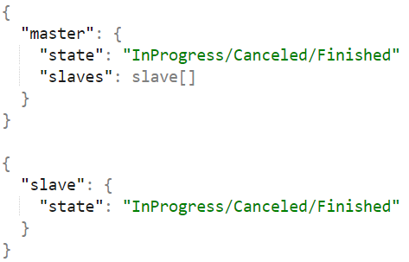
Aggregated State – Solution 1
What if we have are cycling dependencies?

Slide 12
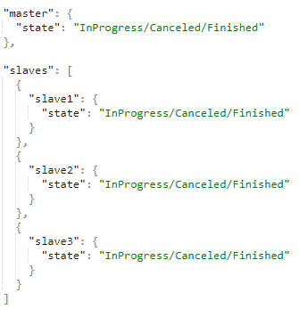
Aggregated State – Solution 1
Can you give examples for invalid states?

Slide 13
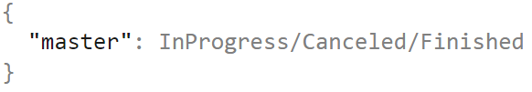
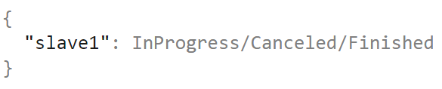
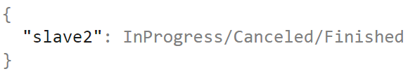
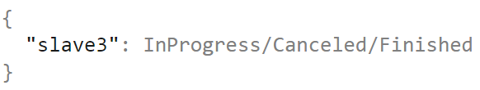
Aggregated State – Solution 1
We request all states at the same “time”
F
IP
C
IP
C
IP
C
IP
F

Slide 14
Aggregated State – Solution 1
We request from salves and only then from master
F
IP
C
IP
C
IP
C
IP
F

Slide 15
Aggregated State – Solution 1
We request from master and only then from slaves
F
IP
F
IP
F
IP
F
IP
F

Slide 16
Aggregated State – Solution 2
Distributed Realtime Solution tuning algorithm vector
(D.r. S.t.a.v)
I’m still creating this algorithm so it won’t be presented today…

Slide 17

Aggregated State – Solution 3 - Redux

Slide 18
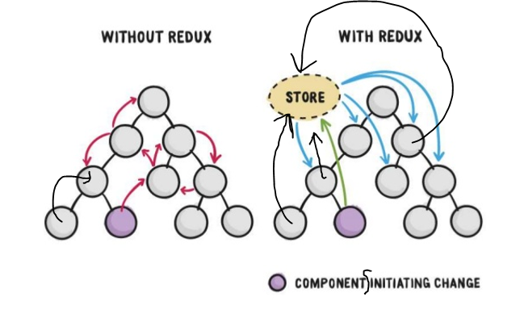
Aggregated State – Solution 3 - Redux
How redux works

Slide 19
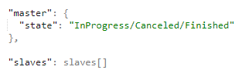
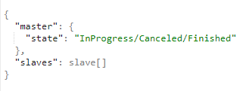
Aggregated State – Solution 3 - Redux
Multiple objects to state tree

Slide 20
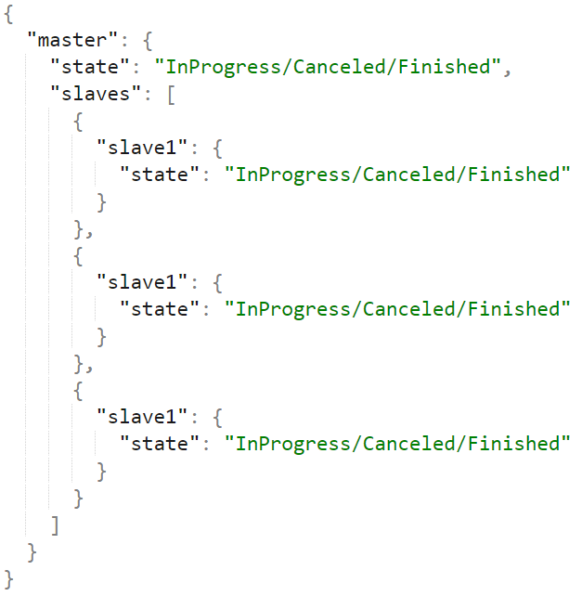
Aggregated State – Solution 3 - Redux
Example for a state tree object

Slide 21
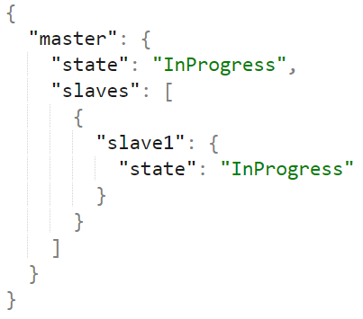
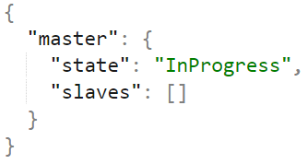
Aggregated State – Solution 3 - Redux
How does the timeline of the store will look like?
Store

Slide 22

Aggregated State – Solution 3 - Redux
With redux, each state is valid and most up to date
master
F
IP
F
Slave1
IP
F
Store
Slave2
IP
F
Slave3
IP
F

Slide 23
Aggregated State – Solution 3 - Redux
With redux, each state is valid and most up to date
master
F
IP
F
Slave1
IP
F
Store
Slave2
IP
F
Slave3
IP
F

Slide 24
Aggregated State – Solution 3 - Redux
With redux, each state is valid and most up to date
F
IP
F
IP
F
IP
F
IP
F

Slide 25
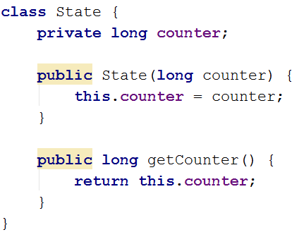
Aggregated State – Redux Example
State tree

Slide 26
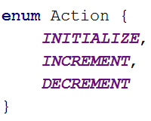
Aggregated State – Redux Example
Actions

Slide 27
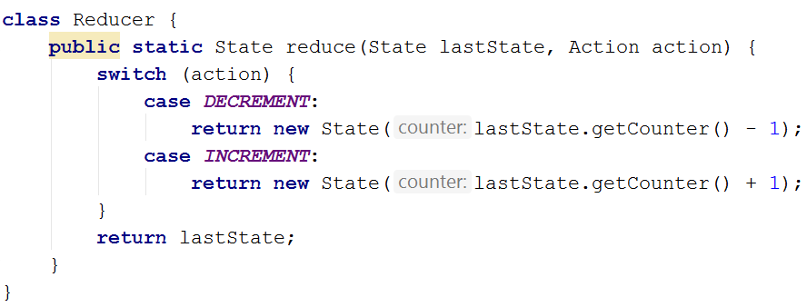
Aggregated State – Redux Example
Actions

Slide 28
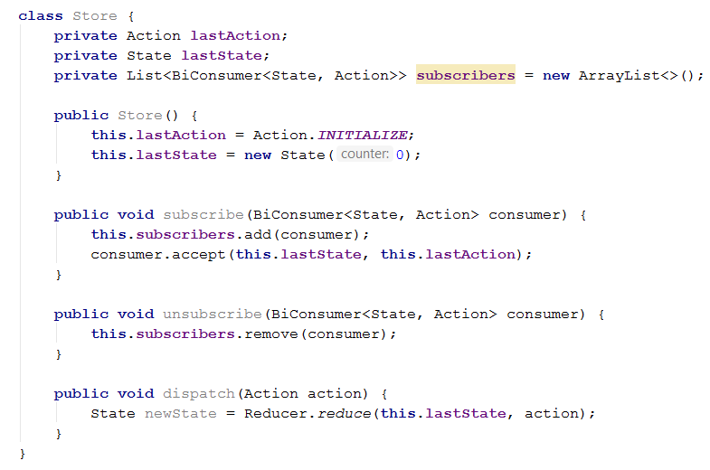

Slide 29

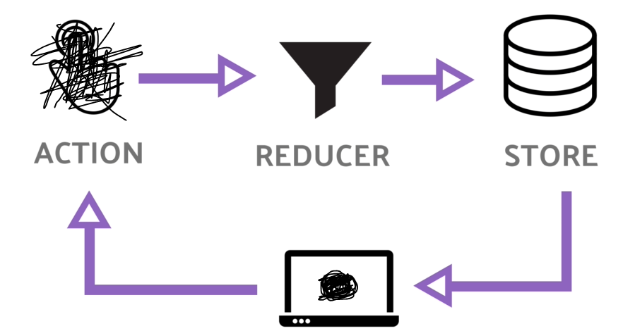



Aggregated State – Solution 3 - Redux
How does Redux works?

Slide 30
Where to go from here?
Redux
Multithreading

Slide 31
Where to go from here? Multithreading
Functional Programming in Java 8 - Part 3 - Streams In Depth – Intro
Functional Programming in Java 8 - Part 4 - Optional and Primitive Streams
Functional Programming in Java 8 - Part 5 - Reactive Streams

Slide 32
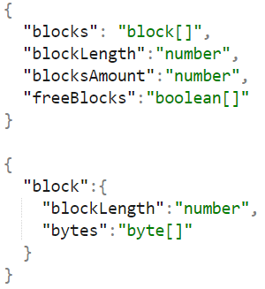
Aggregated State – Exercise
Analyze the dependencies and implement your redux

